Slide 1
DSA
Singly Linked List

Slide 2
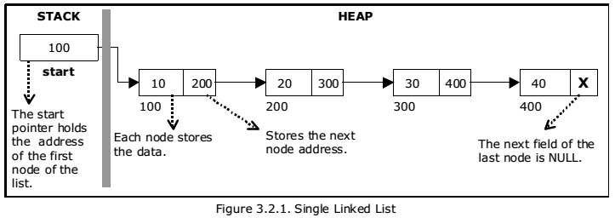
Introduction
A singly linked list is a linear data structure that consists of a sequence of elements called nodes, where each node contains two parts: data and a reference (or link) to the next node in the sequence.

Slide 3
Pseudo Code – To Insert

Slide 4
Pseudo Code – To Display

Slide 5
Thanks For Watching

